Slide 1

Distributed & Cloud Computing
Welcome
Sukkur IBA University
Week – 09
Lecture – 17&18
Your Facilitator, Adil Khan

Slide 2
Cloud Storage
Azure Storage Service

Slide 3
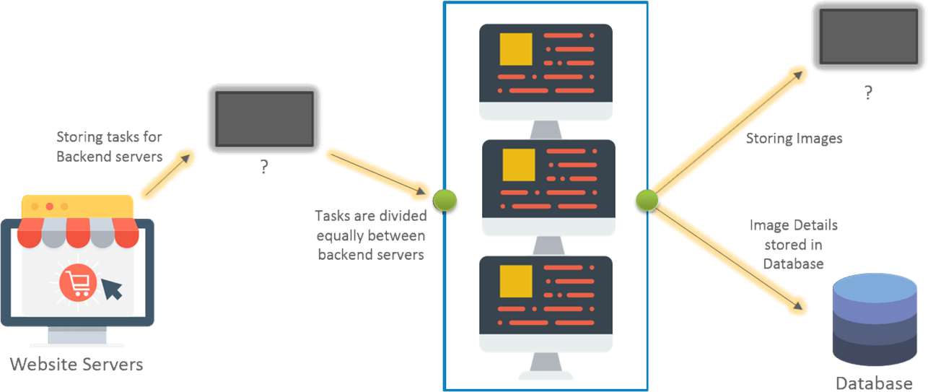
Why do we need Storage?
Notes:
Example: Image Processing Application

Slide 4
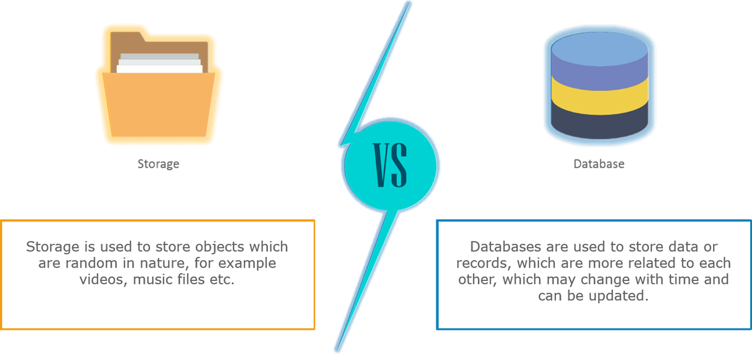
Storage vs Database?

Slide 5
Azure Storage?
The goal is to allow users and applications to
Access their data efficiently from anywhere at anytime
Store data for any length of time
Scale to store any amount of data
Be confident that the data will not be lost
Pay for only what they use/store

Slide 6
Azure Storage?
Azure Storage is the modern-day solution to all storage problems.
Cloud storage solution for modern application
Features:
Durable
Scalable (capacity and throughput)
Highly Available
Security
Performance Efficient

Slide 7
Azure Storage Account
User creates a globally unique storage account name
Provides security for accessing the store
Azure Storage types:
Blob storage
Table storage
File storage
Queue storage
Disk storage
Simple and Familiar Programming Interfaces
REST Accessible and ADO.NET

Slide 8

Blob Storage Concepts
Blob storage –
It is a service that stores unstructured data in the cloud as objects/blobs.
It is optimized to store huge unstructured data.
Storage is in terms of binary large objects (BLOBs).
It can store any type of text or binary data, such as document, media file, or application installer.

Slide 9








Blob Storage Concepts
Account
Container
Blob
IMG001.JPG
pictures
IMG002.JPG
Azuure
Demo
movies
MOV1.AVI

Slide 10
Blob Storage Concepts
Blob Storage Concepts
Azure blob’s responsibilities:
Storing files for shared access
Video and audio streaming
Storing data for analysis
Writing to the log file
Storing data for disaster recovery, backup, and archiving

Slide 11
Blob Storage Concepts
Three types of blobs:
Block Blobs: It is an accumulation of small blocks that have their own unique block IDs. One block blob can contain up to 50,000 blocks.
Append Blobs: Append blobs also comprises blocks, but when you modify these blobs new blocks are added at the end.
Page Blobs: They are comprised of 512-byte pages that are optimized for arbitrary read and write operations.

Slide 12
Blob Storage Concepts
Azure Blob Storage Pricing
The volume of data stored/month
Types of operations performed
Number of operations performed
Data transfer cost, if any
The selected data redundancy option

Slide 13
Blob Storage Concepts
Data redundancy options in Azure Storage.
Locally redundant storage (LRS)
Zone redundant storage (ZRS)
Geo-redundant storage (GRS)
Read-access geo-redundant storage (RA-GRS)

Slide 14
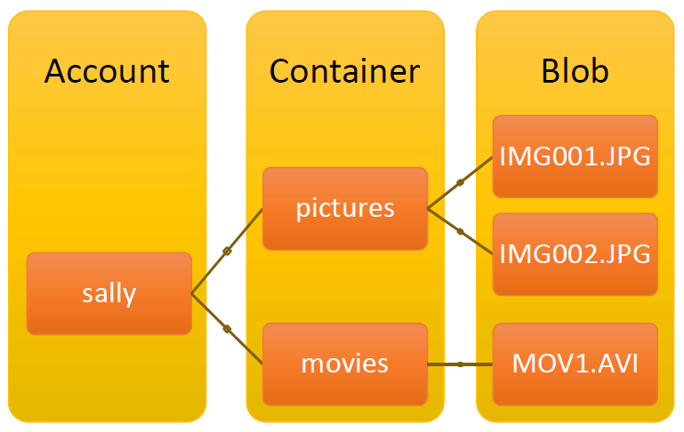
Storage Account And Blob Containers
Storage Account
An account can have many Blob Containers
Container
A container is a set of blobs
Sharing policies are set at the container level
Public READ or Private
Associate Metadata with Container
Metadata is
<name, value> pairs
List the blobs in a container
movies
MOV1.AVI

Slide 15
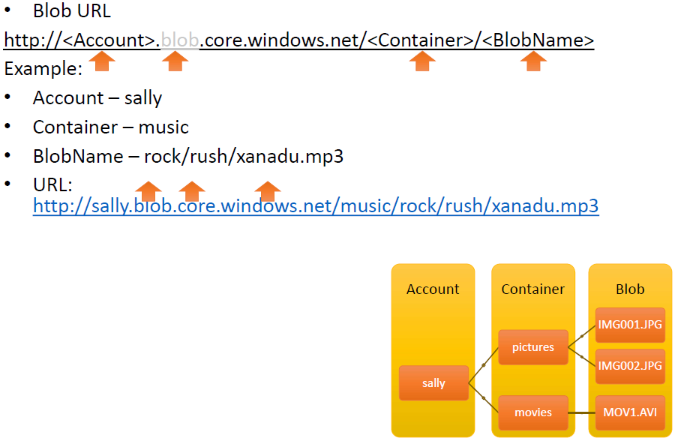
Blob Namespace

Slide 16
Blob Features And Functions
Store Large Objects (up to 50 GB each)
Standard REST PUT/GET Interface
http://<Account>.blob.core.windows.net/<Container>/<BlobName>
PutBlob
Inserts a new blob or overwrites the existing blob
GetBlob
Get whole blob or by starting offset, length
DeleteBlob
Support for Continuation on Upload
Associate Metadata with Blob
Metadata is <name, value> pairs
Set/Get with or separate from blob data bits
Up to 8KB per blob

Slide 17



















Blob Storage Concepts – Adding Blocks
Account
Container
Blob
IMG001.
JPG
IMG002.
JPG
Block
pictures
sally
Block 1
movies
MOV1.AVI
Block 2
Block 3

Slide 18
Blob As A List Of Blocks
Blob
Consists of a List of Blocks
Properties of Blocks
Each Block defined by a Block ID
Up to 64 Bytes, scoped by Blob Name
Blocks are immutable
A block is up to 4MB
Do not have to be same size

Slide 19
BlockList Operations
PutBlockList for a Blob
Provide the list of blocks to comprise the readable version of the blob
If multiple blocks are uploaded with same Block ID – Last committed block wins
Blocks not used will be garbage collected
GetBlockList for a Blob
Returns the list of blocks that represent the readable (committed) version of the blob
Block ID and Size of Block is returned for each block

Slide 20



REST PutBlock
Account Container Blob Name
PUT
http://dvd.blob.core.windows.net/movies/TheBlob.wmv
?comp=block &blockid=BlockId1 &timeout=60 HTTP/1.1 Content-Length: 4194304
Content-MD5: HUXZLQLMuI/KZ5KDcJPcOA==
Authorization: SharedKey dvd:
F5a+dUDvef+PfMb4T8Rc2jHcwfK58KecSZY+l2naIao=
x-ms-date: Mon, 27 Oct 2008 17:00:25 GMT
……… Block Data Contents ………

Slide 21
REST PutBlockList
Account Container Blob Name
PUT
http://dvd.blob.core.windows.net/movies/TheBlob.wmv
?comp=bocklist &timeout=120
HTTP/1.1 Content-Length: 161213
Content-MD5: HUXZLQLMuI/KZ5KDcJPcOA==
Authorization: SharedKey dvd:
F5a+dUDvef+PfMb4T8Rc2jHcwfK58KecSZY+l2naIao=
x-ms-date: Mon, 27 Oct 2008 17:00:25 GMT
……… Block Data Contents ………

Slide 22
REST GetBlob
Get whole blob
GET
http://dvd.blob.core.windows.net/movies/TheBlob.wmv HTTP/1.1
Authorization: SharedKey dvd:
RGllHMtzKMi4y/nedSk5Vn74IU6/fRMwiPsL+uYSDjY=
X-ms-date: Mon, 27 Oct 2008 17:00:25 GMT
Get a range of the blob
GET
http://dvd.blob.core.windows.net/movies/TheBlob.wmv
?timeout=60 HTTP/1.1
Range: bytes=1024000-2048000

Slide 23
Summary Of Azure Blobs
Easy to use REST Put/Get/Delete interface
Can read from any Offset, Length of Blob
Conditional Put and Get Blob
Max Blob size
50 GB using PutBlock and PutBlockList
64 MB using PutBlob
Blocks provide continuation for blob upload
Put Blob/BlockList == Replace Blob for CTP
Can replace an existing blob with new blob/blocks

Slide 24

Table Storage Concepts
Table storage – It has now become a part of Azure Cosmo DB. Azure table stores structured NNoSQL data.

Slide 25
Table Storage Concepts
It provides managed file sharing in the cloud.
Stores large amounts of structured data.
The service is a NoSQL datastore
Azure tables are ideal for storing structured, non-relational data

Slide 26
Table Storage Concepts
Provides Structured Storage
Massively Scalable Tables
Billions of entities (rows) and TBs of data
Automatically scales to thousands of servers as traffic grows
Highly Available
Can always access your data
Durable
Data is replicated at least 3 times
Familiar and Easy to use Programming Interfaces
ADO.NET Data Services – .NET 3.5 SP1
.NET classes and LINQ(Language Integrated Query)
REST - with any platform or language

Slide 27
Table Data Model
Table
A Storage Account can create many tables
Table name is scoped by Account
Data is stored in Tables
A Table is a set of Entities (rows)
An Entity is a set of Properties (columns)
Entity
Two “key” properties that together are the unique ID of the entity in the Table
PartitionKey – enables scalability
RowKey – uniquely identifies the entity within the partition

Slide 28
Partition Key And Partitions
Every Table has a Partition Key
It is the first property (column) of your Table
Used to group entities in the Table into partitions
A Table Partition
All entities in a Table with the same partition key value
Partition Key is exposed in the programming model
Allows application to control the partitions and enable scalability

Slide 29
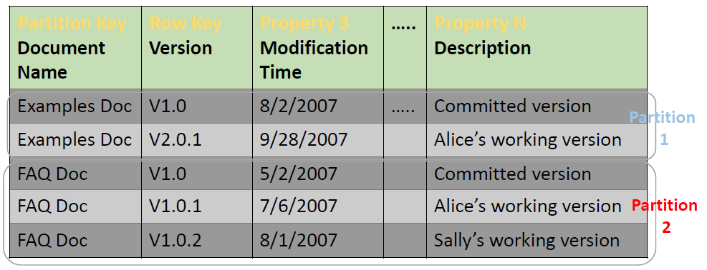


Partition Example

Slide 30
Summary Of Azure Tables
Built to provide Massively Scalable, Highly Available and Durable Structured Storage
Automatic Load Balancing and Scaling of Tables
Partition Key is exposed to the application
Familiar and Easy to use LINQ and REST programming interfaces
ADO.Net Data Services
Not a “relational database”
No joins, no maintenance of foreign keys, etc
Notes:
LINQ: Language Integrated Query

Slide 31

Queue Storage Concepts

Slide 32
Queue Storage Concepts
A service for storing large numbers of messages that can be accessed from anywhere in the world via authenticated calls using HTTP or HTTPS.
A single queue message can be up to 64 KB in size, and a queue can contain millions of messages, up to the total capacity limit of a storage account.

Slide 33
Windows Azure Queues
Provide reliable message delivery
Simple, asynchronous work dispatch
Programming semantics ensure that a message can be processed at least once
Queues are Highly Available, Durable and Performance Efficient
Access is provided via REST

Slide 34
Account, Queues And Messages
An Account can create many Queues
Queue Name is scoped by the Account
A Queue contains Messages
No limit on number of messages stored in a Queue
But a Message is stored for at most a week
http://<Account>.queue.core.windows.net/<QueueName>
Messages
Message Size <= 8 KB
To store larger data, store data in blob/entity storage, and the blob/entity name in the message

Slide 35
Queue Programming API
Queues
Create/Clear/Delete Queues
Inspect Queue Length
Messages
Enqueue (QueueName, Message)
Dequeue (QueueName, Invisibility Time T)
Returns the Message with a MessageID
Makes the Message Invisible for Time T
Delete(QueueName, MessageID)

Slide 36


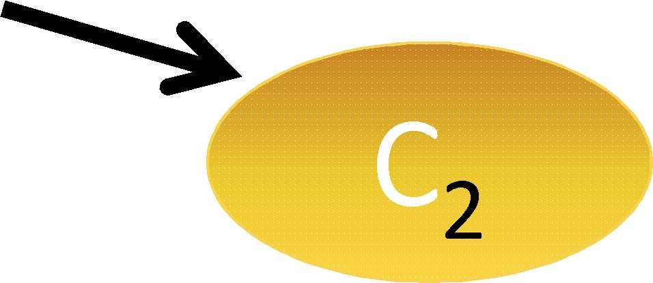

Dequeue And Delete Messages
Producers Consumers
P₂
C₁
1. Dequeue(Q, 30 sec) -> msg 1
4 3 2 1
3
2
2
1
1
P₁
2
2. Dequeue(Q, 30 sec) -> msg 2

Slide 37



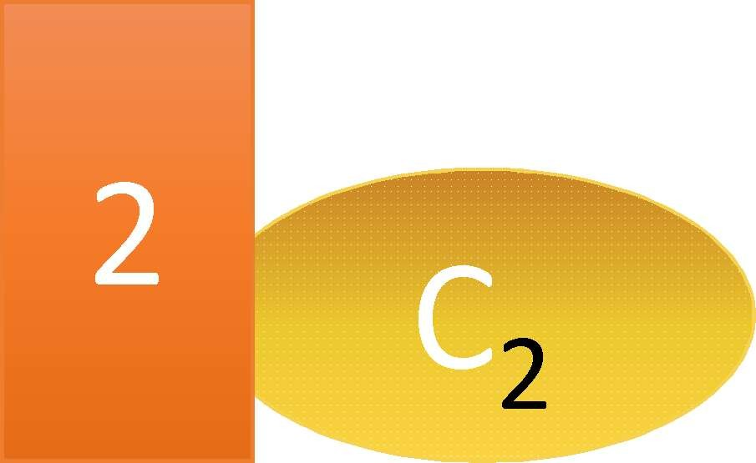

Dequeue And Delete Messages
Producers Consumers
P₂
1 C
1. Dequeue(Q, 30 sec) -> msg 1
5. C₁ crashed
4 3 2 1
6. msg1 visible 30 seconds after Dequeue
3
1
P₁
2
Benefit:
Insures that every message can be processed at least once
Dequeue(Q, 30 sec) -> msg 2
C2 consumed msg 2
Delete(Q, msg 2)
7. Dequeue(Q, 30 sec) -> msg 1

Slide 38
Summary Of Azure Queues
Provide reliable message delivery
Allows Messages to be retrieved and processed at least once
No limit on number of messages stored in a Queue
Message size is <=8KB

Slide 39

File Storage Concepts
File storage – It is a fully managed file sharing service in the cloud or on premise via the Server Message Block (SMB) protocol.
An account can contain an unlimited number of shares, and a share can store an unlimited number of files, up to the 5 TB total capacity of the file share.

Slide 40
Disk Storage Concepts
Disk storage – It is a virtual hard disk (VHD) which is of two types: managed and unmanaged.
Further divided into two:
Managed
Unmanaged
Azure Managed Disk is a virtual hard disk which is mostly like a physical disk that is virtualized.
In unmanaged disks, you need to have storage accounts that can hold the disks for Azure VM.

Slide 41
Storage Durability
All data is replicated at least 3 times
Replicas are spread out over different fault and upgrade domains in same data center
All of Storage (Blobs, Tables and Queues) is built on this replication layer
Dynamic replication to maintain a healthy number of replicas
Recover from a lost/unresponsive Drive or Node
Recover from data bit rot
Data continuously scanned against bit rot

Slide 42
Availability And Scalability
Efficient Failover
Data served immediately elsewhere within data center from available replicas
Automatic Load Balancing of Hot Data
Monitor the usage patterns and load balance access to
Blob Containers, Table Partitions and Queues
Distribute access to the hot data over the data center according to traffic
Caching of Hot Blobs, Entities and Queues
Hot Blobs are cached to scale out access to them
Hot Entity and Queue data pages are cached and served from memory

Slide 43
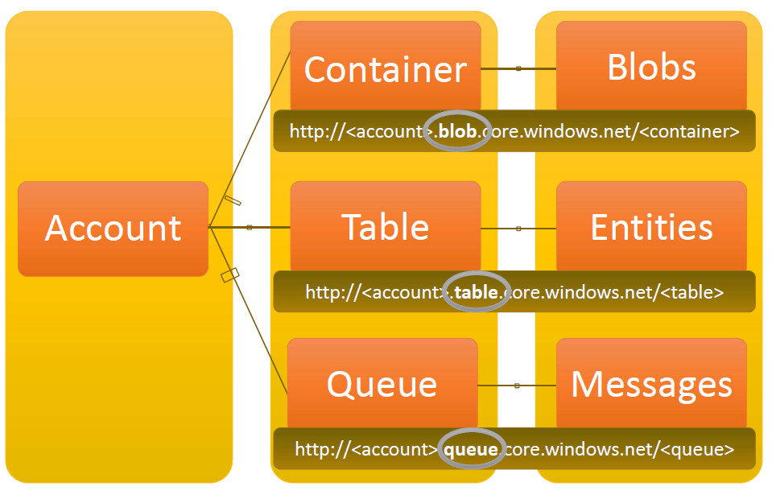
Azure Data Storage Concepts

Slide 44
Thank you!
Any Questions???

